Slide 1
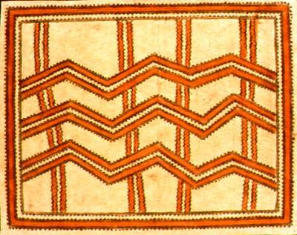
Bark cloth of the pacific preserving a traditional Art
Part II of a research project compiled
By Sheri Majewski

Slide 2
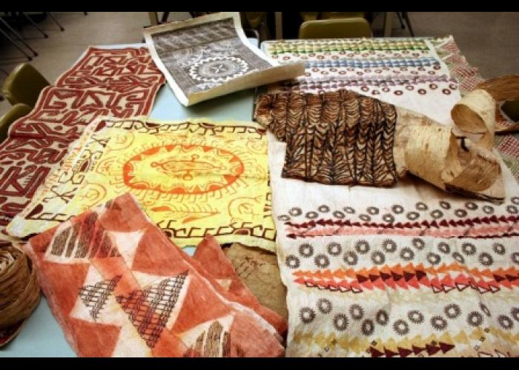
Commonly known as tapa, bark cloth is found throughout the Pacific Islands. The shared techniques and processes are evidence of vibrant cultural diffusion and historical relationships

Slide 3
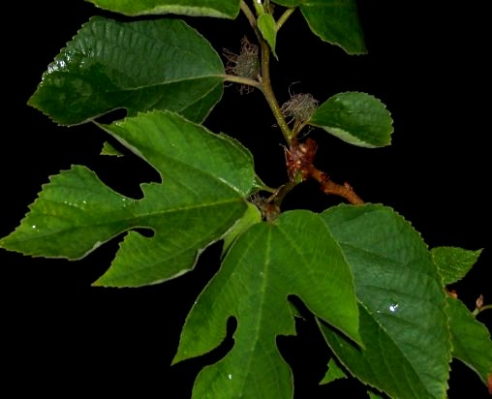
RAW MATERIALS USED
-Paper Mulberry Tree (Broussonetia papyrifera)
-Sometimes also breadfruit or ficus tree bark
-Natural pigment dyes

Slide 4
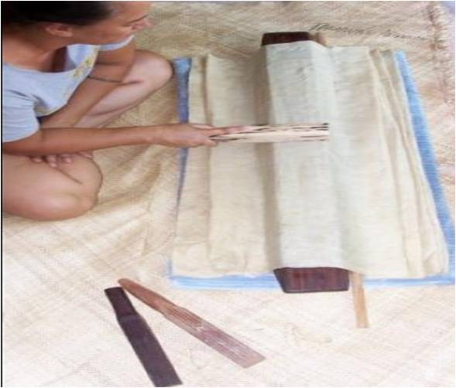
BASIC TOOLS USED
-Sharp cutting shells
-Wooden clubs
-WOODEN ANVIL
-sTONES
-WATER

Slide 5
BASIC PROCESS
-Separate inner bark from outer bark
-Cut inner bark into strips
-Soak strips in water to prepare for pounding

Slide 6
BASIC TECHNIQUE
Clubs are used to pound, flatten, and widen bark strips into cloth
3 Types of Clubs:
-rounded and smooth
-square and grooved
-carved with a special signature mark

Slide 7
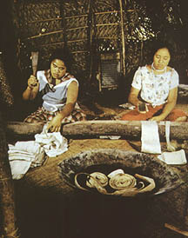
STRIPS ARE SOAKED, POUNDED PAPER THIN AND WIDE

Slide 8
2 METHODS ARE USED TO JOIN STRIPS & LENGTHEN CLOTH
Western Islands Eastern Islands
Pasting
paste and pound to join strips TO make a stiff cloth
Felting
overlap and pound to join strips TO make a soft cloth

Slide 9
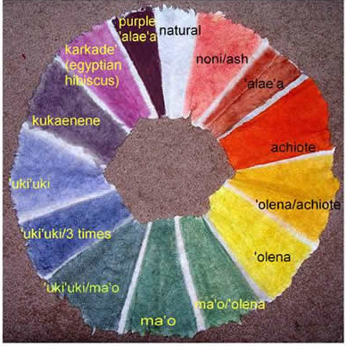
TAPA DESIGN
Natural dyes
Hand painting
Block prints
Leaf prints
Stencils
Designs from nature
Designs from family origins – genealogy
Designs from cultural stories or news

Slide 10
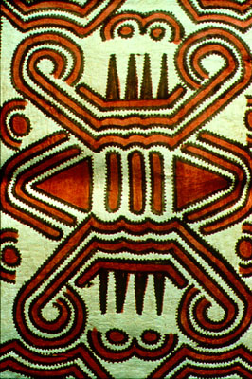
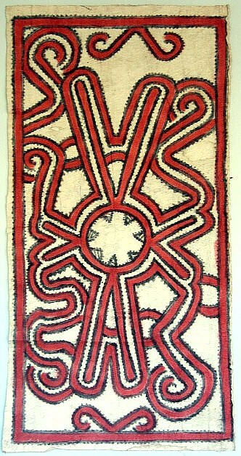
Designs of the West
Papua New guinea
Irian jaya

Slide 11
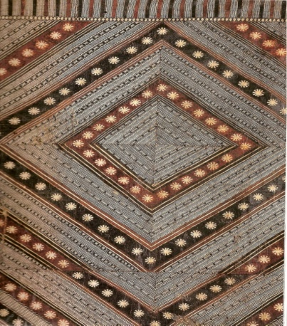
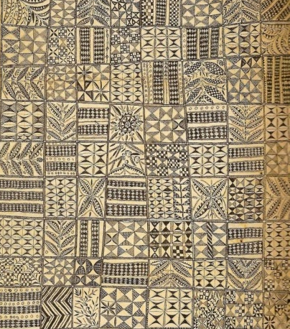
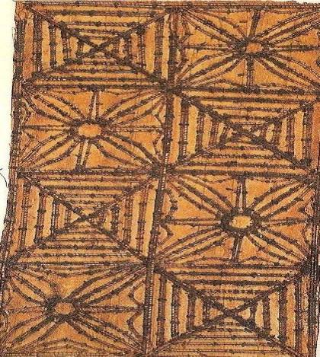
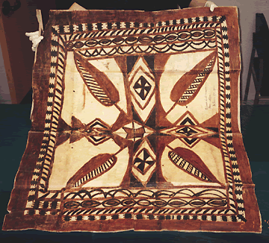
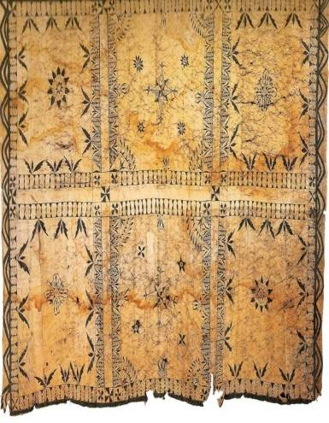
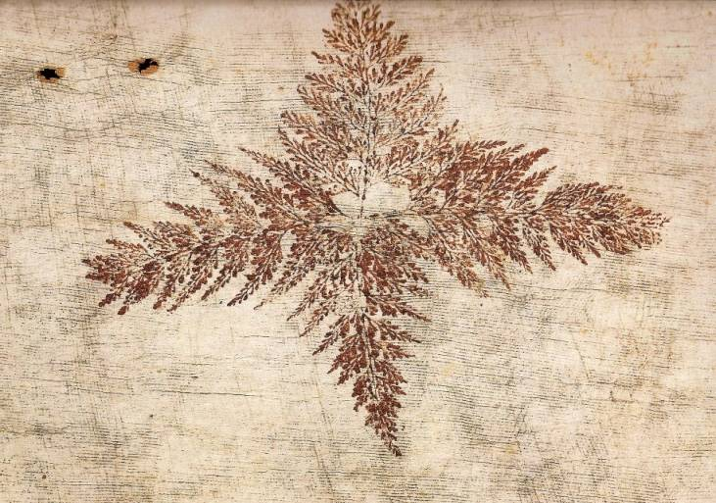
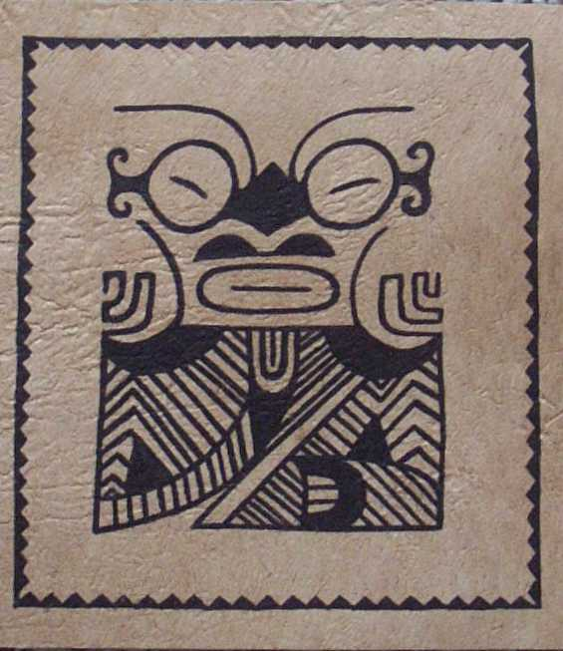
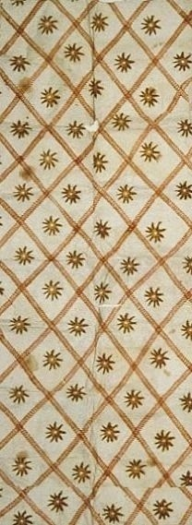
Designs of the East
FIJI
NIUE
TONGA
SAMOA
UVEA
TAHITI
MARQUESAS
HAWAI’I

Slide 12
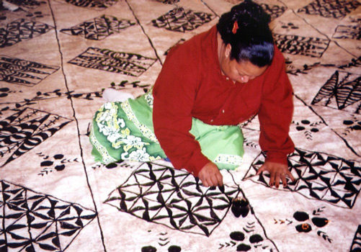
TONGAN TAPA is NGATU

Slide 13
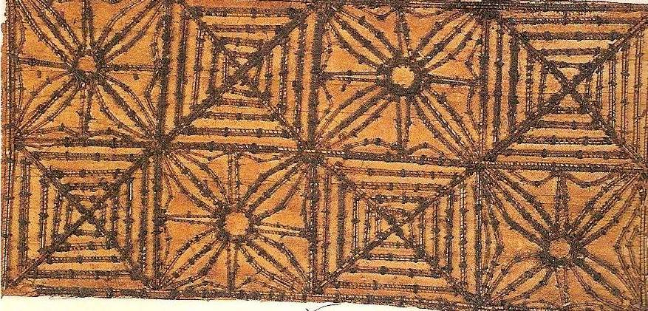
TONGAN NGATU DESIGN PRINTING BLOCK - KUPESI COCONUT MIDRIB SEWN ONTO LEAVES

Slide 14
TONGAN NGATU DESIGN KUPESI PRINT RUBBING WITH HAND PAINTED OVERLAY

Slide 15
SAMOAN TAPA is SIAPO

Slide 16
SAMOAN SIAPO
Carved Wood Printing Blocks – UPETI

Slide 17
SAMOAN SIAPO DESIGN
UPETI - Printing blocks

Slide 18
SAMOAN SIAPO DESIGN
H A N D PA I N T I N G

Slide 19
FIJIAN TAPA is MASI

Slide 20
FIJIAN MASI STENCIL DESIGN TECHNIQUE

Slide 21
SOCIETY ISLANDS TAPA is AHU

Slide 22
SOCIET Y ISLANDS TAPA TAHITIAN Leaf Print DESIGNS

Slide 23
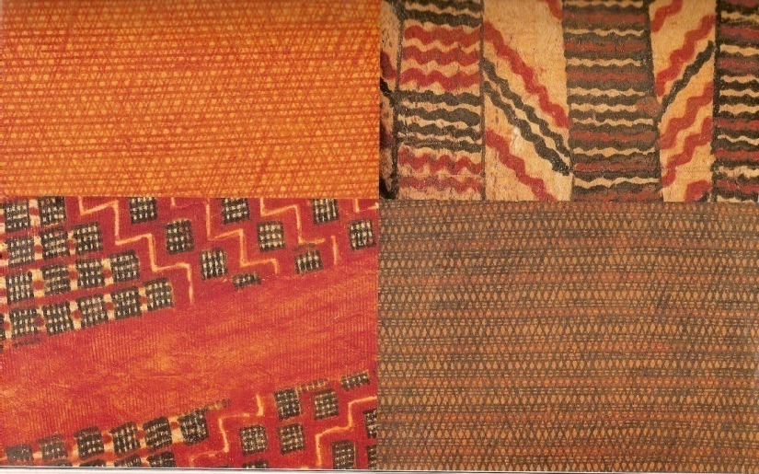
HAWAIIAN TAPA is KAPA

Slide 24
HAWAIIAN KAPA DESIGN ‘OHE KAPALA ( bamboo stamps)

Slide 25
HAWAIIAN KAPA DESIGN ‘OHE KAPALA CARVED BAMBOO STAMPING TOOLS

